Slide 1
#
C
o
p
y
r
i
g
h
t
©
2
0
1
4
~
2
0
9
9
§9.3 Laplace 㡨㑍㚟
.
㭎㐃㖿㮪㛺㖻㘐㦺 —— Laplace 㡨㑍㚟㘐㦺
㖎㐃㤴 Laplace 㡨㑍㚟㔻㗉㗡
®
X
i
e
s
o
n
g
f
a
@
H
U
S
T
.
$
9
8
!
䍤
䈻
㺖
#
C
o
p
y
r
i
g
h
t
©
2
0
1
4
~
2
0
9
9
.
®
X
i
e
s
o
n
g
f
a
@
H
U
S
T
.
$
9
8
䍤
䈻
㺖
!

Slide 2





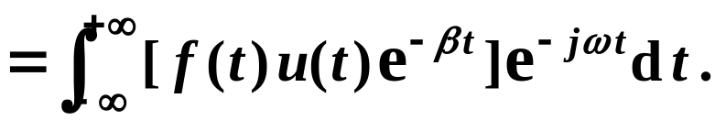

㭎㐃㖿㮪㛺㖻㘐㦺 —— Laplace 㡨㑍㚟㘐㦺
#
C
o
p
y
r
i
g
h
t
©
2
0
1
4
~
2
0
9
9
.
1. 㘐㦺㩡㔭
(1)
㩡㔭䶦䶧
㧞㙽㨞 㔻 Laplace 㑍㚟㪈 㐂
®
X
i
e
s
o
n
g
f
a
@
H
U
S
T
.
$
9
8
㜚
!
(2)
㘤㾦 Laplace 㑍㚟㭐 Fourier 㑍㚟㔻㘔㬛㐂
㝳㰝㐅
䍤
䈻
㺖
#
C
o
p
y
r
i
g
h
t
©
2
0
1
4
~
2
0
9
9
㙽㨞 㔻 Laplace 㑍㚟
.
㝈㧂 㙽㨞 㔻 Fourier 㑍㚟㐆
®
X
㜶
i
e
s
o
n
g
f
a
@
H
U
S
T
.
$
9
8
䍤
䈻
㺖
!

Slide 3
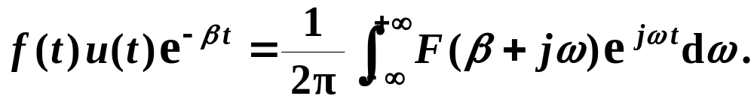


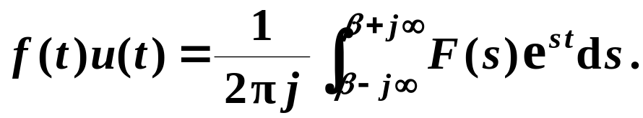
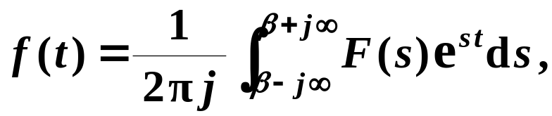

㭎㐃㖿㮪㛺㖻㘐㦺 —— Laplace 㡨㑍㚟㘐㦺
#
C
o
p
y
r
i
g
h
t
©
2
0
1
4
~
2
0
9
9
.
1. 㘐㦺㩡㔭
(3)
㩡㔭䶦䶧
㘤㾦 Fourier 㡨㑍㚟㘐㦺㐂
㭼
®
X
i
e
s
o
n
g
f
a
@
H
U
S
T
.
$
9
8
!
(4)
㛜㦚㦺㟦㑥㩃㒢
㑑㮂
㭼
䍤
䈻
㺖
#
C
o
p
y
r
i
g
h
t
©
2
0
1
4
~
2
0
9
9
.
®
X
i
e
s
o
n
g
f
a
@
H
U
S
T
.
$
9
8
䍤
䈻
㺖
㜶㕛
!

Slide 4
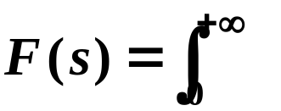








㭎㐃㖿㮪㛺㖻㘐㦺 —— Laplace 㡨㑍㚟㘐㦺
#
C
o
p
y
r
i
g
h
t
©
2
0
1
4
~
2
0
9
9
.
2. 㖿㮪㛺㖻㘐㦺
㘤㾦㦚㠩㔻㩡㔭㐂㕛㔟㥟㫉㔻 Laplace 㑍㚟㔫:
®
X
i
e
s
o
n
g
f
a
@
H
U
S
T
.
$
9
8
!
( A )
( B )
䍤
䈻
㺖
#
C
o
p
y
r
i
g
h
t
©
2
0
1
4
~
2
0
9
9
.
㔩㮮䶫䶬
㓊 ( B ) 㦺㪈㖿㮪㛺㖻㘐㦺㐆
㰕䶔䶕䶖
㖿㮪㛺㖻㘐㦺㯣㔻㛺㖻䁤㝂㧂
®
X
c
i
e
s
o
n
g
f
a
@
H
U
S
T
.
$
9
8
s
!
䍤
䈻
㺖
㣛㠩㦚㔻㭎㩍㰙㫫
㘰㰙㫫㪌㮺 㔻㒶㯹㮾㯣㐆

Slide 5

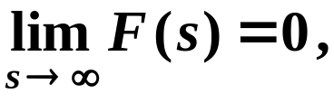


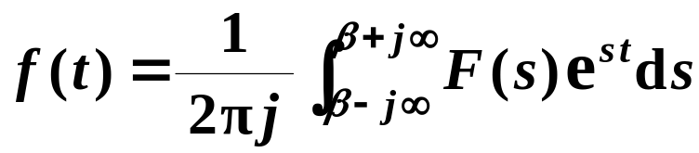









㖎㐃㤴 Laplace 㡨㑍㚟㔻㗉㗡
#
C
o
p
y
r
i
g
h
t
©
2
0
1
4
~
2
0
9
9
.
1. 㟮㨞㗡
㬕㗡䶯䶰䶱
㟠㮀㟮㨞㜘㧒㖿㮪㛺㖻㐆
®
X
i
e
s
o
n
g
f
a
@
H
U
S
T
.
$
9
8
㔩㟂䶡䶢
㧞 㔻㫑㙽㨞 㓜㭼㫽㙀㙌㟈㤠㔷
!
P 228
㪎㧂㝀㫧㔻㐂
㯱㔫㮺 㐂
㤂
㭼
定理
9.2
䍤
䈻
㺖
#
C
o
p
y
r
i
g
h
t
©
2
0
1
4
~
2
0
9
9
.
㰕䶯䶰䶱
㮂㮺 㯹㒶㯹㮾 㡲㝀㫧㐂
㭨㓆 㔻㤠㔷㛚㯹 㦚㐆
®
X
i
e
s
o
n
g
f
a
@
H
U
S
T
.
$
9
8
䍤
䈻
㺖
c
!
㐁㟄㐇
㰷㠗䶢䶣
㐁㜤㥳?㐇

Slide 6
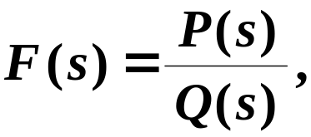



㖎㐃㤴 Laplace 㡨㑍㚟㔻㗉㗡
#
C
o
p
y
r
i
g
h
t
©
2
0
1
4
~
2
0
9
9
.
2. 㓂㑣㗡
㬕㗡䶩䶪䶫
㟠㮀 Laplace 㑍㚟㔻㘖㱧㫝㰻㐂㑑㘤㾦㭎㬙㭬㰝㙽㨞㔻
®
X
i
e
s
o
n
g
f
a
@
H
U
S
T
.
$
9
8
Laplace 㑍㚟㟀㤴㡨㑍㚟㐆
!
㮸㨈䵳䵴䵵
㔧㔥㨞㤼㞏㫉㐂㫑㙽㨞 㩕㒺㪈㐁㰛㐇㖻㦺㙽㨞㐅
䍤
䈻
㺖
#
C
o
p
y
r
i
g
h
t
©
2
0
1
4
~
2
0
9
9
.
㤆㯣㐂 㚋 㧂㦴㬛㨞㔥㬁㦺㐆
®
㮂㮺㖻㦺㙽㨞㰃㡦㖻㝀㪈㔥㬁㦺㚋㑫㖻㖻㦺㐂㭨㓆㐂
X
i
e
s
o
n
g
f
a
@
H
U
S
T
.
$
9
8
䍤
䈻
㺖
!
㟠㮀㓂㑣㗡㭸㕛㫑㭠㙽㨞㐆
㐁㑫㖻㖻㦺㖻㝀㐇

Slide 7









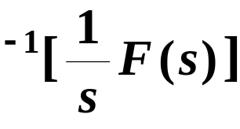
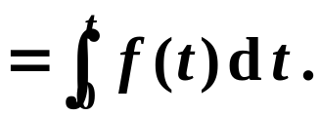



㖎㐃㤴 Laplace 㡨㑍㚟㔻㗉㗡
#
C
o
p
y
r
i
g
h
t
©
2
0
1
4
~
2
0
9
9
.
2. 㓂㑣㗡
㛔㙀㒺㮀㔻 Laplace 㡨㑍㚟㔻㫝㰻㐆
®
X
i
e
s
o
n
g
f
a
@
H
U
S
T
.
$
9
8
!
䍤
䈻
㺖
#
C
o
p
y
r
i
g
h
t
©
2
0
1
4
~
2
0
9
9
.
®
X
i
e
s
o
n
g
f
a
@
H
U
S
T
.
$
9
8
䍤
䈻
㺖
!

Slide 8
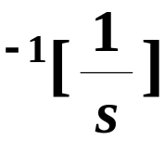
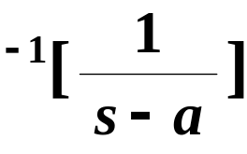


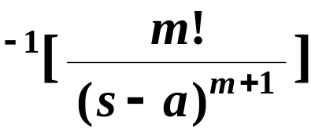
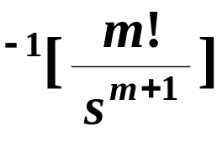


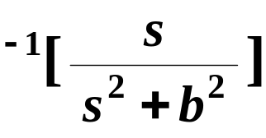
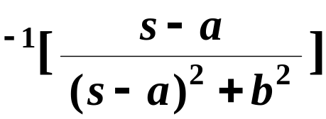


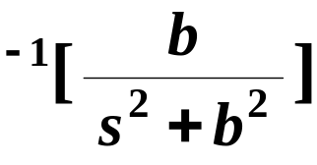
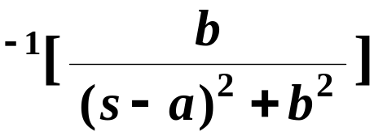







㖎㐃㤴 Laplace 㡨㑍㚟㔻㗉㗡
#
C
o
p
y
r
i
g
h
t
©
2
0
1
4
~
2
0
9
9
.
2. 㓂㑣㗡
㛔㙀㒺㮀㙽㨞㔻 Laplace 㡨㑍㚟㐆
®
X
i
e
s
o
n
g
f
a
@
H
U
S
T
.
$
9
8
!
䍤
䈻
㺖
#
C
o
p
y
r
i
g
h
t
©
2
0
1
4
~
2
0
9
9
.
®
X
i
e
s
o
n
g
f
a
@
H
U
S
T
.
$
9
8
䍤
䈻
㺖
!

Slide 9
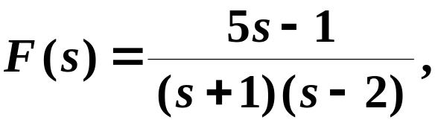

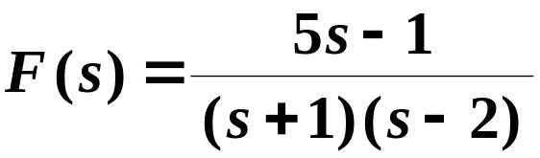
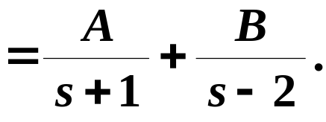



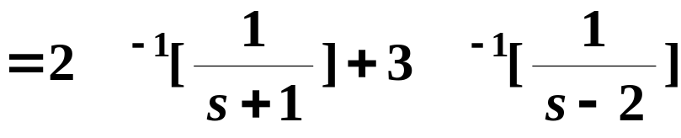

#
C
o
p
y
r
i
g
h
t
©
2
0
1
4
~
2
0
9
9
㞶䶚䶛䶜
.
㭬㰝
㤴
㝀䶠䶡䶢
㗉㗡 1
㟠㮀㓂㑣㗡㤴㝀㐆
®
X
2
3
i
e
s
o
n
g
f
a
@
H
U
S
T
.
$
9
8
(1)
!
㐁㔣㘤㐇
䍤
䈻
㺖
(2)
㮂
#
C
o
p
y
r
i
g
h
t
©
2
0
1
4
~
2
0
9
9
.
㕛
®
X
i
e
s
o
n
g
f
a
@
H
U
S
T
.
$
9
8
䍤
䈻
㺖
!

Slide 10



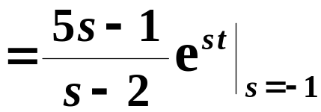


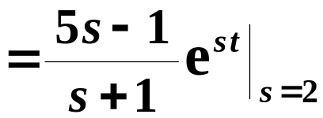

#
C
o
p
y
r
i
g
h
t
©
2
0
1
4
~
2
0
9
9
㞶䶚䶛䶜
.
㭬㰝
㤴
㝀䶠䶡䶢
㗉㗡 2
㟠㮀㟮㨞㗡㤴㝀㐆
®
X
i
e
s
o
n
g
f
a
@
H
U
S
T
.
$
9
8
(1) 㪈 㔻㭎㜬㛬㔷㐂
!
䍤
䈻
㺖
#
C
o
p
y
r
i
g
h
t
©
2
0
1
4
~
2
0
9
9
.
(2)
®
X
i
e
s
o
n
g
f
a
@
H
U
S
T
.
$
9
8
䍤
䈻
㺖
!

Slide 11
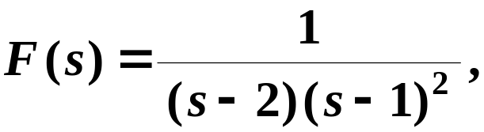
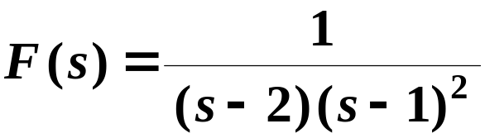
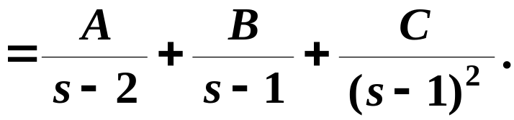

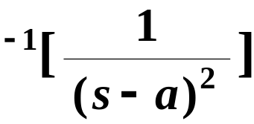


#
C
o
p
y
r
i
g
h
t
©
2
0
1
4
~
2
0
9
9
㞶䶚䶛䶜
.
㭬㰝
㤴
P 229 例 9.17
㝀䶠䶡䶢
㗉㗡 1
㟠㮀㓂㑣㗡㤴㝀㐆
®
X
i
e
s
o
n
g
f
a
@
H
U
S
T
.
$
9
8
(1)
!
㐁㓖㘤㐇
1
− 1
− 1
䍤
䈻
㺖
#
C
o
p
y
r
i
g
h
t
©
2
0
1
4
~
2
0
9
9
.
(2)
㮂
®
X
i
e
s
o
n
g
f
a
@
H
U
S
T
.
$
9
8
䍤
䈻
㺖
㕛
!

Slide 12

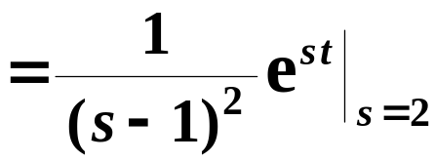

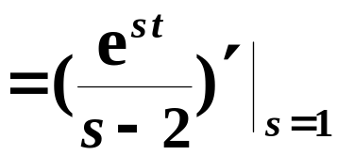


#
C
o
p
y
r
i
g
h
t
©
2
0
1
4
~
2
0
9
9
㞶䶚䶛䶜
.
㭬㰝
㤴
P 229 例 9.17
㝀䶠䶡䶢
㗉㗡 2
㟠㮀㟮㨞㗡㤴㝀㐆
®
X
i
e
s
o
n
g
f
a
@
H
U
S
T
.
$
9
8
!
(1) 㖻㒁㪈 㔻㭎㜬㭐㖎㜬㛬㔷㐂
䍤
䈻
㺖
#
C
o
p
y
r
i
g
h
t
©
2
0
1
4
~
2
0
9
9
.
(2)
®
X
i
e
s
o
n
g
f
a
@
H
U
S
T
.
$
9
8
䍤
䈻
㺖
!

Slide 13
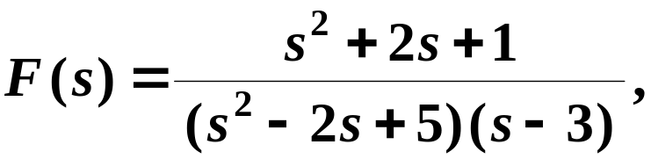
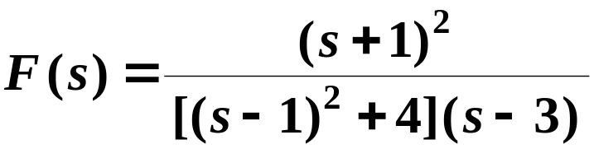
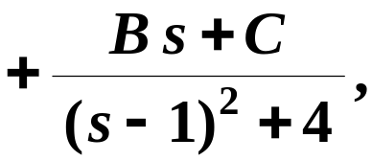
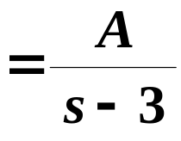
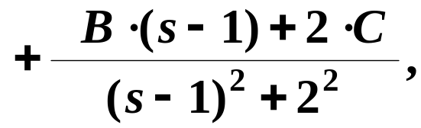






#
C
o
p
y
r
i
g
h
t
©
2
0
1
4
~
2
0
9
9
㞶䶚䶛䶜
.
㭬㰝
㤴
㝀䶠䶡䶢
㗉㗡 1
㟠㮀㓂㑣㗡㤴㝀㐆
®
X
i
e
s
o
n
g
f
a
@
H
U
S
T
.
$
9
8
(1)
㐁㗅㘤㐇
!
2
− 1
1
䍤
䈻
㺖
#
C
o
p
y
r
i
g
h
t
©
2
0
1
4
~
2
0
9
9
.
㞴
㕛
®
X
i
e
s
o
n
g
f
a
@
H
U
S
T
.
$
9
8
䍤
䈻
㺖
㞴
㕛
!

Slide 14
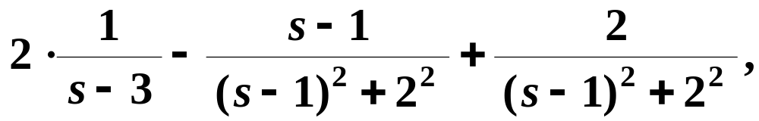

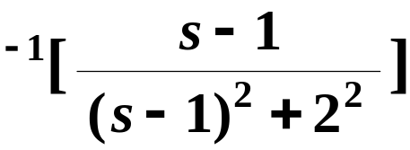

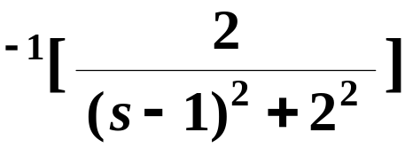


#
C
o
p
y
r
i
g
h
t
©
2
0
1
4
~
2
0
9
9
㞶䶚䶛䶜
.
㭬㰝
㤴
㝀䶠䶡䶢
㗉㗡 1
㟠㮀㓂㑣㗡㤴㝀㐆
®
X
i
e
s
o
n
g
f
a
@
H
U
S
T
.
$
9
8
(1)
!
(2)
2
− 1
1
㮂
䍤
䈻
㺖
#
C
o
p
y
r
i
g
h
t
©
2
0
1
4
~
2
0
9
9
.
®
X
i
e
s
o
n
g
f
a
@
H
U
S
T
.
$
9
8
䍤
䈻
㺖
!
㕛

Slide 15




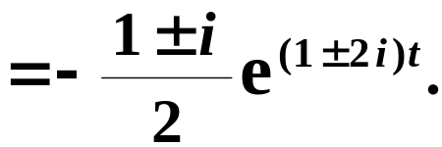
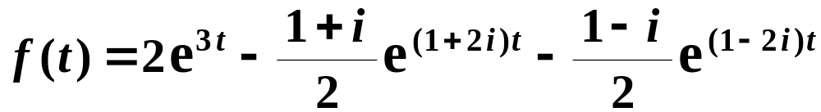

#
C
o
p
y
r
i
g
h
t
©
2
0
1
4
~
2
0
9
9
㞶䶚䶛䶜
.
㭬㰝
㤴
㝀䶠䶡䶢
㗉㗡 2
㟠㮀㟮㨞㗡㤴㝀㐆
®
X
(1) 㪈 㔻㭎㜬㛬㔷㐂
i
e
s
o
n
g
f
a
@
H
U
S
T
.
$
9
8
!
䍤
䈻
㺖
#
C
o
p
y
r
i
g
h
t
©
2
0
1
4
~
2
0
9
9
.
(2)
®
X
i
e
s
o
n
g
f
a
@
H
U
S
T
.
$
9
8
䍤
䈻
㺖
!

Slide 16

#
C
o
p
y
r
i
g
h
t
©
2
0
1
4
~
2
0
9
9
.
®
X
i
e
s
o
n
g
f
a
@
H
U
S
T
.
$
9
8
!
䍤
䈻
㺖
#
C
o
p
y
r
i
g
h
t
©
2
0
1
4
~
2
0
9
9
.
®
X
i
e
s
o
n
g
f
a
@
H
U
S
T
.
$
9
8
䍤
䈻
㺖
!
……
放松一下吧 !

Slide 17







㗙㐅
㟠㮀㟮㨞㜘㧒㖿㮪㛺㖻㔻㔩㟂㰷㠗
#
C
o
p
y
r
i
g
h
t
©
2
0
1
4
~
2
0
9
9
.
㔩㟂䶡䶢
㧞 㔻㫑㙽㨞 㓜㭼㫽㙀㙌㟈㤠㔷
P 228
㪎㧂㝀㫧㔻㐂
㯱㔫㮺 㐂
㤂
㭼
定理
9.2
®
X
i
e
s
o
n
g
f
a
@
H
U
S
T
.
$
9
8
!
(1)
㰷㠗䶢䶣
㥟㩅㐂
㯩㑭䆏㫫
#
C
o
p
y
r
i
g
h
t
©
2
0
1
4
~
2
0
9
9
.
s
L
㮂㮺㙽㨞 㯹 㣛㠩㦚㪒㤠㔷㐂
c
㖐 㔻㤠㔷㛚㯹 㦚㐂
C_{R}
®
X
㭨㓆㐂㔳 R 㒪㖻㔧㧀㐂
㝳㦢㕛
i
e
s
o
n
g
f
a
@
H
U
S
T
.
$
9
8
!
㔻㦼㭼㤠㔷㕥㑉㚉㯹 C 㪠㒼㔻㤞㮾㡲㐆

Slide 18
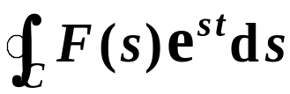

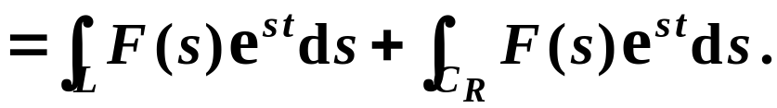
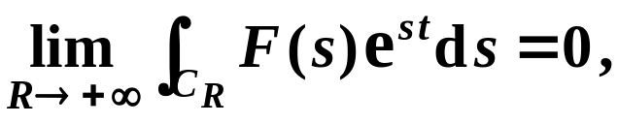

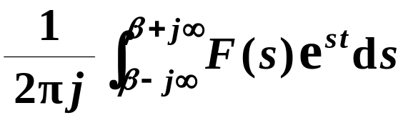
㗙㐅
㟠㮀㟮㨞㜘㧒㖿㮪㛺㖻㔻㔩㟂㰷㠗
#
C
o
p
y
r
i
g
h
t
©
2
0
1
4
~
2
0
9
9
.
(2)
㰷㠗䶢䶣
㘤㾦㟮㨞㔩㟂㐂
㭼
®
X
i
e
s
o
n
g
f
a
@
H
U
S
T
.
$
9
8
!
㟠㮀㥧㖡㔳㮲㟂㐁 5.3㐇㐂
§
㝳㩡㕛
#
C
o
p
y
r
i
g
h
t
©
2
0
1
4
~
2
0
9
9
.
L
c
C_{R}
㜶㕛
®
X
i
e
s
o
n
g
f
a
@
H
U
S
T
.
$
9
8
!
㐁㗕㚡㐇

Slide 19



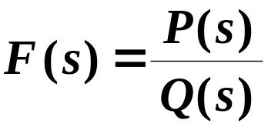
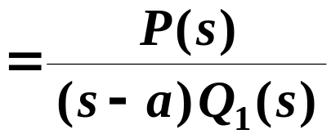
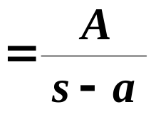
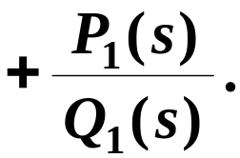

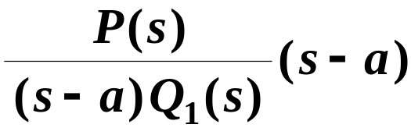
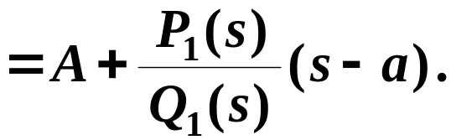



㗙㐅
㛜㦴㬛㨞㰛㖻㦺 㚁㪈㑫㖻㖻㦺
#
C
o
p
y
r
i
g
h
t
©
2
0
1
4
~
2
0
9
9
.
1. 㖻㠿 㯣㚉㭼㔣㓖㭎㜬㭨㯽㔻㤼㞏
㗉㗡䶲䶳
㧞 㚉㔣㓖㭎㜬㭨㯽
㜶
®
X
i
e
s
o
n
g
f
a
@
H
U
S
T
.
$
9
8
!
㯱
䍤
䈻
㺖
㛜㦚㦺㟦㑥㩃㒢㭖 㐂
㭼
#
C
o
p
y
r
i
g
h
t
©
2
0
1
4
~
2
0
9
9
.
®
X
i
e
s
o
n
g
f
a
@
H
U
S
T
.
$
9
8
䍤
䈻
㺖
!
㞴
㜶㕛

Slide 20








㗙㐅
㛜㦴㬛㨞㰛㖻㦺 㚁㪈㑫㖻㖻㦺
#
C
o
p
y
r
i
g
h
t
©
2
0
1
4
~
2
0
9
9
.
2. 㖻㠿 㯣㚉㭼㔥㓖㭎㜬㭨㯽㔻㤼㞏
㗉㗡䶲䶳
㧞 㚉 n 㓖㭎㜬㭨㯽
㜶
®
X
i
e
s
o
n
g
f
a
@
H
U
S
T
.
$
9
8
!
㯱
䍤
䈻
㺖
#
C
o
p
y
r
i
g
h
t
©
2
0
1
4
~
2
0
9
9
.
㛜㦚㦺㟦㑥㩃㒢㭖 㐂
㭼
®
X
i
e
s
o
n
g
f
a
@
H
U
S
T
.
$
9
8
䍤
䈻
㺖
!

Slide 21





㗙㐅
㛜㦴㬛㨞㰛㖻㦺 㚁㪈㑫㖻㖻㦺
#
C
o
p
y
r
i
g
h
t
©
2
0
1
4
~
2
0
9
9
.
2. 㖻㠿 㯣㚉㭼㔥㓖㭎㜬㭨㯽㔻㤼㞏
㗉㗡䶲䶳
㞴
㜶㕛
®
X
i
e
s
o
n
g
f
a
@
H
U
S
T
.
$
9
8
!
㟦㑥㱛㓄㤴㔭㐂
㑑㭚㓄㞴
㜶㕛
䍤
䈻
㺖
#
C
o
p
y
r
i
g
h
t
©
2
0
1
4
~
2
0
9
9
.
®
X
i
e
s
o
n
g
f
a
@
H
U
S
T
.
$
9
8
䍤
䈻
㺖
!

Slide 22






㗙㐅
㛜㦴㬛㨞㰛㖻㦺 㚁㪈㑫㖻㖻㦺
#
C
o
p
y
r
i
g
h
t
©
2
0
1
4
~
2
0
9
9
.
㖻㫧䶪䶫
㤜㠩㩑㟖㞲 㯣㚉㭼㔣㓖㚋㔥㓖㭎㜬㭨㯽㔻㤼㞏㐂
㥟㘢㯹㗅㨞㗏㪠㡲㖻㝀㐂㱁㟦㱧㤼㞏㭬㜈㘘㞲㐆
®
X
i
e
s
o
n
g
f
a
@
H
U
S
T
.
$
9
8
!
㕙㥟㘢㛈㯹㦴㨞㗏㪠㡲㖻㝀㐂㱁㟦㱧㤼㞏㚕㐿㘘㐆
㯹㦴㬛㨞㔥㬁㦺㯣㐂㗅㟬㔷㰃㧂㙵㪈㘒㖒㒬㬑㐂
㜶
䍤
䈻
㺖
㥟㘢㗅㨞 㪈 㔻㟬㔷㐂
#
C
o
p
y
r
i
g
h
t
©
2
0
1
4
~
2
0
9
9
.
㯱㗅㨞 㭔㪈 㔻㟬㔷㐆
㮂㮺 㐂
㭨㓆㯹㦴㨞㗏㪠㡲㐂
®
㖻㠿 㔻㰍㫛㭨㯽㰳㔥㪈㖎㜬㭨㯽㐆
X
i
e
s
o
n
g
f
a
@
H
U
S
T
.
$
9
8
䍤
䈻
㺖
!
㫉㠩㯵㫿㜤㭎㑛㩑㟖㚉㦴㖎㜬㭨㯽㔻㤼㞏㐆

Slide 23










㗙㐅
㛜㦴㬛㨞㰛㖻㦺 㚁㪈㑫㖻㖻㦺
#
C
o
p
y
r
i
g
h
t
©
2
0
1
4
~
2
0
9
9
.
3. 㖻㠿 㯣㚉㭼㔣㓖㖎㜬㭨㯽㔻㤼㞏
㗉㗡䶲䶳
㧞 㚉 㔣㓖㖎㜬㭨㯽
㜶
®
X
i
e
s
o
n
g
f
a
@
H
U
S
T
.
$
9
8
!
㯱
䍤
䈻
㺖
#
C
o
p
y
r
i
g
h
t
©
2
0
1
4
~
2
0
9
9
.
㛜㦚㦺㟦㑥㩃㒢㭖 㐂
㕛
®
X
i
e
s
o
n
g
f
a
@
H
U
S
T
.
$
9
8
䍤
䈻
㺖
!

Slide 24






㗙㐅
㛜㦴㬛㨞㰛㖻㦺 㚁㪈㑫㖻㖻㦺
#
C
o
p
y
r
i
g
h
t
©
2
0
1
4
~
2
0
9
9
.
3. 㖻㠿 㯣㚉㭼㔣㓖㖎㜬㭨㯽㔻㤼㞏
㗉㗡䶲䶳
㞴
㯱㭼
®
X
i
e
s
o
n
g
f
a
@
H
U
S
T
.
$
9
8
!
㜶㕛
䍤
䈻
㺖
#
C
o
p
y
r
i
g
h
t
©
2
0
1
4
~
2
0
9
9
.
®
X
i
e
s
o
n
g
f
a
@
H
U
S
T
.
$
9
8
䍤
䈻
㺖
4. 㖻㠿 㯣㚉㭼㔥㓖㖎㜬㭨㯽㔻㤼㞏㐁㟄㐇
㐁㗕㚡㐇
!

Slide 25
#
C
o
p
y
r
i
g
h
t
©
2
0
1
4
~
2
0
9
9
.
®
X
i
e
s
o
n
g
f
a
@
H
U
S
T
.
$
9
8
!
䍤
䈻
㺖
#
C
o
p
y
r
i
g
h
t
©
2
0
1
4
~
2
0
9
9
.
®
X
i
e
s
o
n
g
f
a
@
H
U
S
T
.
$
9
8
䍤
䈻
㺖
!
……
放松一下吧 !

